Slide 1
REVISION IN CVS
By
DR.G.AARTHIPRIYANKA
POST GRADUATE
DEPARTMENT OF PHARMACOLOGY

Slide 2
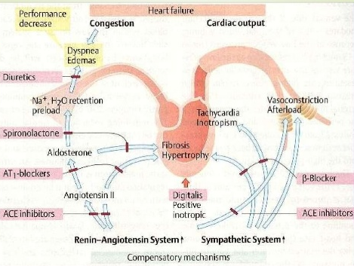
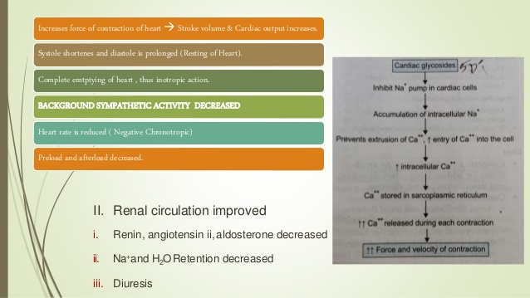
REVISION ON DRUGS IN CCF
DRUGS USED IN CCF
DIGOXIN – MECHANISM OF ACTION

Slide 3
TOPICS TO BE REVISED
DIURETICS
ANTI HYPERTENSIVES
ANTI ARRTHYMICS
ANTI ANGIAL DRUGS
CHELATING AGENTS
DRUGS IN SHOCK

Slide 4
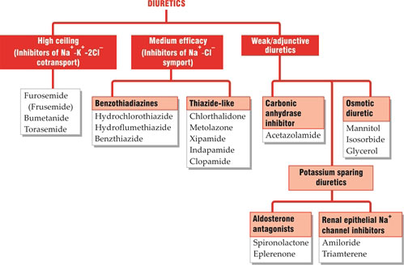
DIURETICS

Slide 5
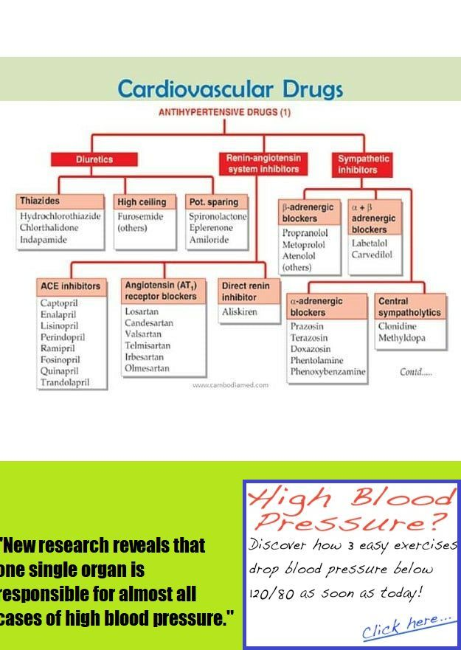
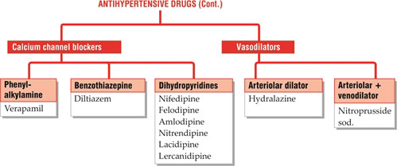
Antihypertensive drugs

Slide 6
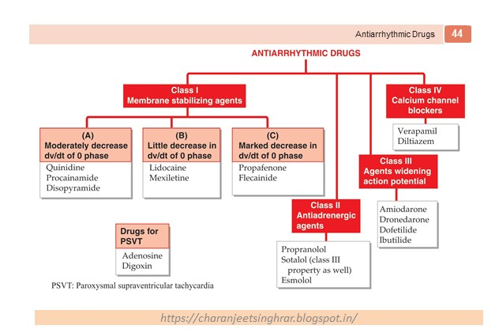
Antiaarthymic drugs

Slide 7
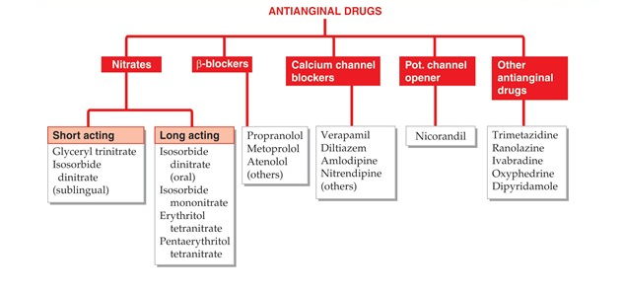
Anti-anginal drugs

Slide 8
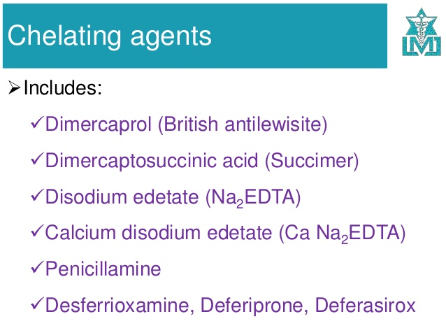

Slide 9
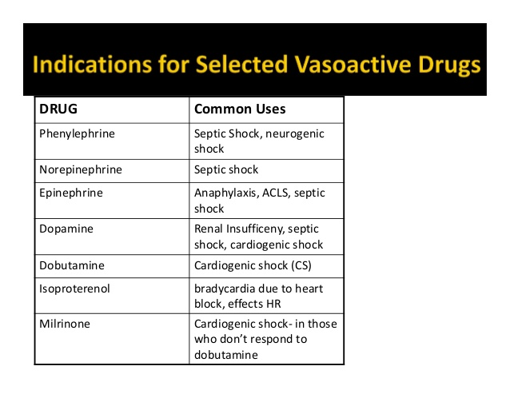
DRUGS IN SHOCK

Slide 10
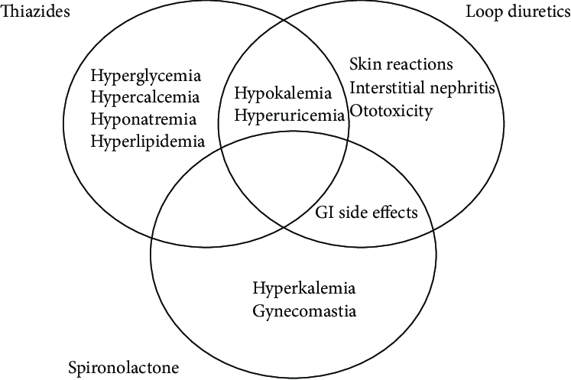
COMMON ADVERSE EFFECTS

Slide 11
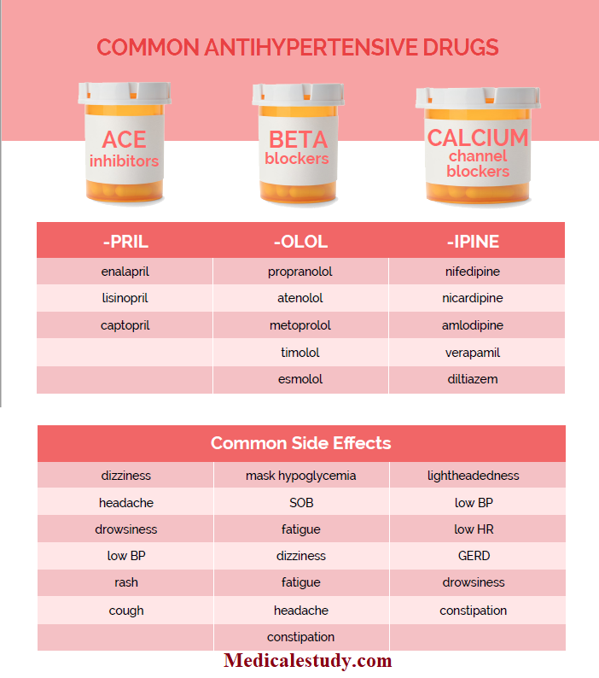

Slide 12
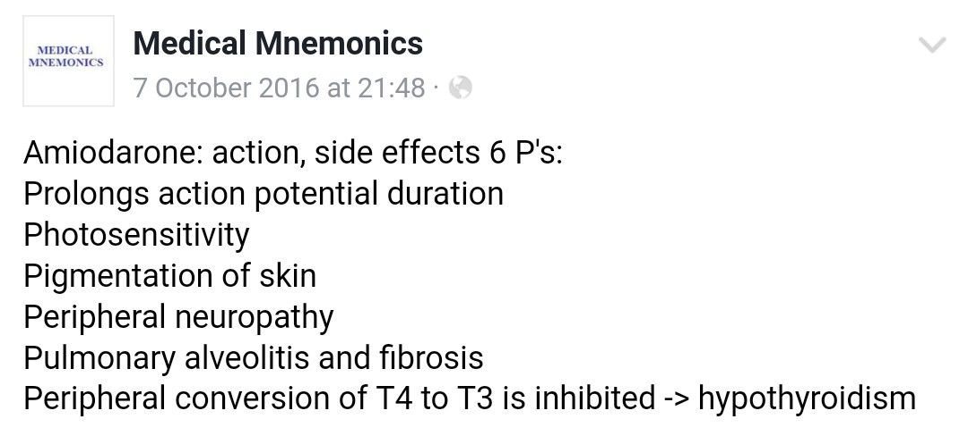
ANTI-ARRTHYMICS SIDE EFFECTS

Slide 13
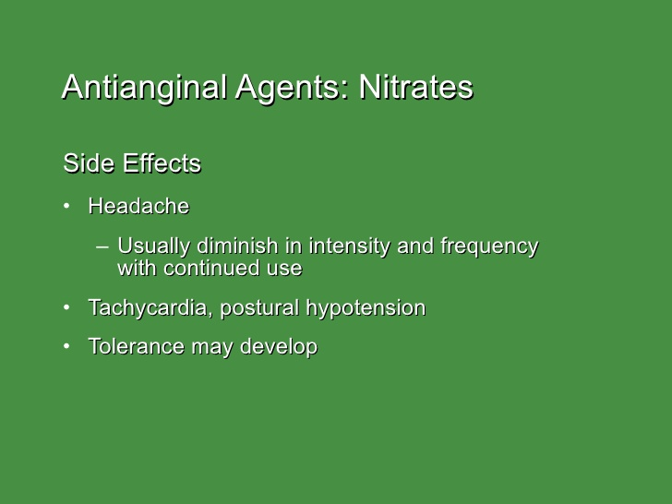

Slide 14
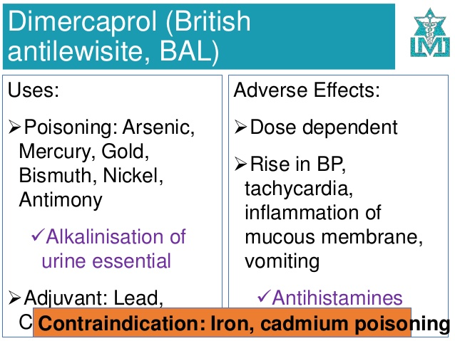

Slide 15
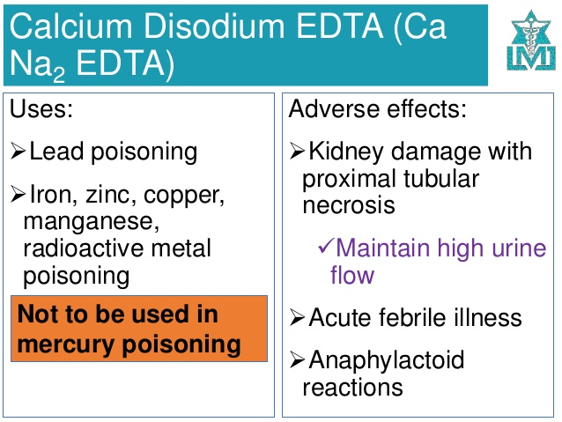

Slide 16
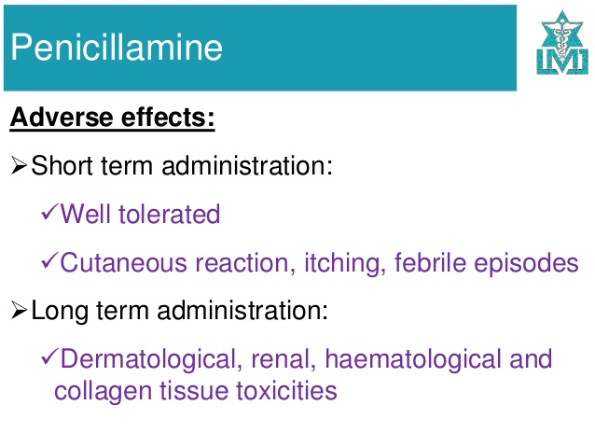

Slide 17
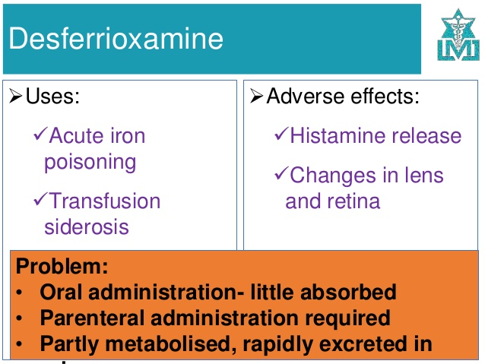

Slide 18
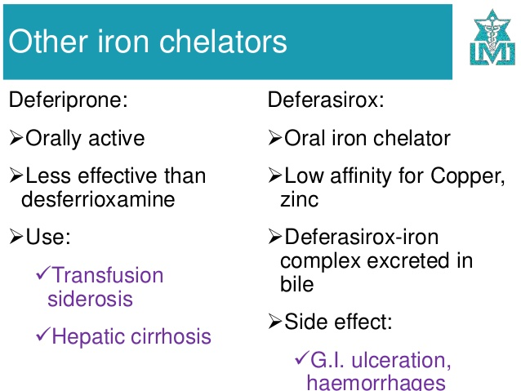

Slide 19
ASSIGNMENT
ESSAY:
Write an essay on calcium channel blockers,their mechanism of action,uses,contraindication and adverse effects?
SHORT ANSWERS:
Name 4 chelating agents
Name 4 drugs used in shock
Name 4 antihypertensive agents
Name 4 antiarrhythmic drugs
Name 4 drugs used in CCF

